Slide 1
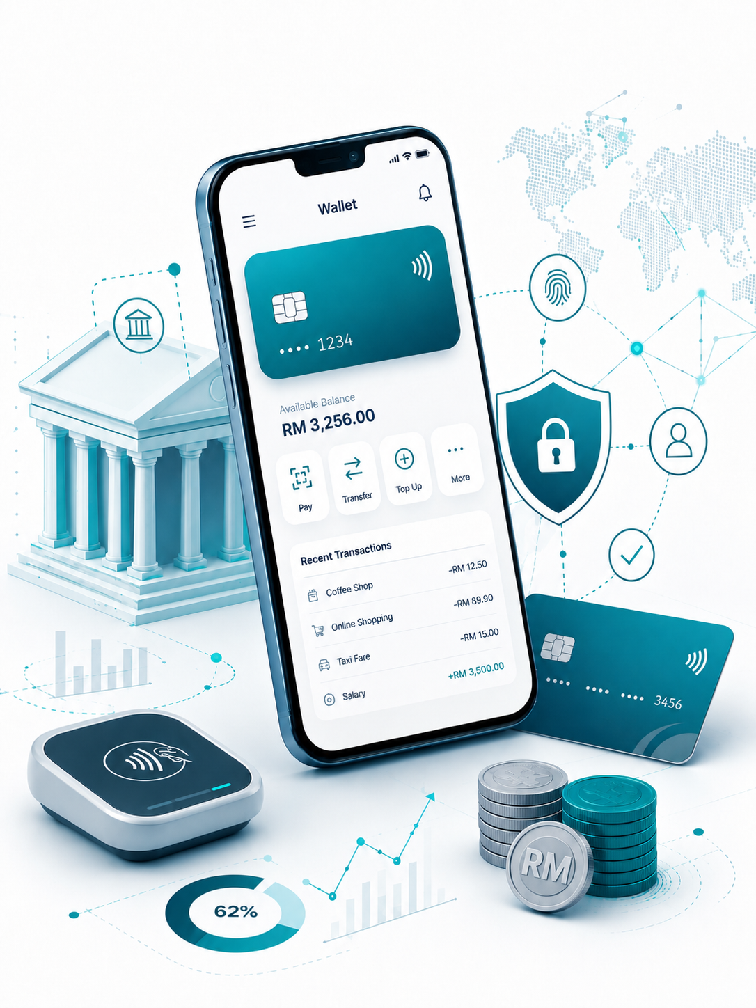

Insert relevant picture related to the topic
TFB3323 FINTECH INNOVATION
WEEK VI & VII
DIGITAL-ONLY BANKS
Shuhaida Bt M Shuhidan
(Dr (FSMC/UTP))
BACHELOR OF XXXXXX
DEPARTMENT OF COMPUTING
FACULTY OF SCIENCE, MANAGEMENT & COMPUTING
© 2026 INSTITUTE OF TECHNOLOGY PETRONAS SDN BHD
All rights reserved. No part of this document may be reproduced, stored in a retrieval system or transmitted in any form or by any means (electronic, mechanical, photocopying, recording or otherwise) without the permission of the copyright owner.

Slide 2
RECAP FROM PREVIOUS LECTURE
The Core Concept: Digital-only banks (like Neobanks and Challenger Banks) operate entirely online without physical branches, focusing on a simple, mobile-first experience.
Why Customers Switch: They win users over by offering lower fees, lightning-fast account setups, and highly personalized apps.
The Profit Hurdle: While these startups are great at getting new users, most struggle to actually make money and are now being pressured to reach profitability.
How Old Banks React: Traditional banks are fighting back by building their own digital-only brands, buying out startups, or partnering with tech companies.
Key Risks: Despite their cool tech, they still face major challenges with cyber attacks, data privacy, and navigating strict banking rules.
Notes:
Learning Outcomes Slide
Note:
Include 2–4 lecture-level learning outcomes
Use measurable action verbs
Map explicitly to Course Learning Outcomes (CLOs)

Slide 3
LEARNING OUTCOMES
By the end of this session, students will be able to:
Understand the fundamental concepts of blockchain, including peer-to-peer systems and distributed ledgers.
Identify the five main benefits of blockchain: enhanced security, greater transparency, instant traceability, increased efficiency, and automation.
Explain the role of asymmetric cryptography and digital signatures in identifying accounts and authorizing transactions.
Describe the blockchain data structure, including block headers, Merkle trees, and how new transaction blocks are chained together.
Compare blockchain to traditional centralized databases and recognize its practical applications across various industries like healthcare, banking, and supply chain.
Notes:
Learning Outcomes Slide
Note:
Include 2–4 lecture-level learning outcomes
Use measurable action verbs
Map explicitly to Course Learning Outcomes (CLOs)

Slide 4
TOPICS
Introduction to Blockchain?
1.1. Peer-to-peer Systems and Distributed Ledgers
1.2. Functional Perspective: Peer-to-Peer vs. Centralized Transactions
1.3. Types of Systems: Centralized, Decentralized, and Distributed
1.4. Advantages of Distributed Systems
Five Important Blockchain Benefits
2.1. Enhanced Security
2.2. Greater Transparency
2.3. Instant Traceability
2.4. Increased Efficiency and Speed
2.5. Automation (Smart Contracts)
Blockchain Basics: Transactions and Blocks
3.1. Distributed Ledger Technology (DLT) Concepts
3.2. The Genesis Block
3.3. Transaction Flow and Immutability
Cryptography in Blockchain
4.1. Identifying and Protecting User Accounts (Asymmetric Cryptography)
4.2. Authorizing Transactions (Digital Signatures Requirements and Use Cases)
4.3. Signing and Verifying a Transaction
Notes:
Engagement and Activity Slides
Note:
Include at least one engagement element where appropriate:
Think–Pair–Share
Mini task
Poll or reflection question
Suggested duration: 3–5 minutes
Activities shall align with learning outcomes

Slide 5
TOPICS
Data Storage and Structure
5.1. Blockchain Data Structure and Merkle Trees
5.2. Block Header Components (Version, Timestamp, Nonce, Difficulty Target, Previous Hash, Merkle Root)
5.3. Process of Adding New Transactions (Chaining Blocks)
Network Operation and Data Integrity
6.1. Roles of Nodes and Miners
6.2. Changing Data in Blockchain
6.3. Blockchain vs. Existing Centralized Databases
How Industries Benefit From Blockchain
7.1. Supply Chains and Food Chain
7.2. Banking and Financial Industry
7.3. Healthcare and Pharmaceuticals
7.4. Government and Insurance
Notes:
Engagement and Activity Slides
Note:
Include at least one engagement element where appropriate:
Think–Pair–Share
Mini task
Poll or reflection question
Suggested duration: 3–5 minutes
Activities shall align with learning outcomes

Slide 6

DISTRIBUTED LEDGER
TECHNOLOGY (BLOCKCHAIN)
Introduction

Slide 7
Financial Technology – Blockchain
1.1. Introduction
Blockchain is a peer-to-peer system of transacting values with no trusted third parties in between.
It is a shared, decentralized, and open ledger of transactions. This ledger database is replicated across a large number of nodes.
This ledger database is an append-only database and cannot be changed or altered. It means that every entry is a permanent entry. Any new entry on it gets reflected on all copies of the databases hosted on different nodes.
There is no need for trusted third parties to serve as intermediaries to verify, secure, and settle the transactions.
Notes:
Engagement and Activity Slides
Note:
Include at least one engagement element where appropriate:
Think–Pair–Share
Mini task
Poll or reflection question
Suggested duration: 3–5 minutes
Activities shall align with learning outcomes

Slide 8
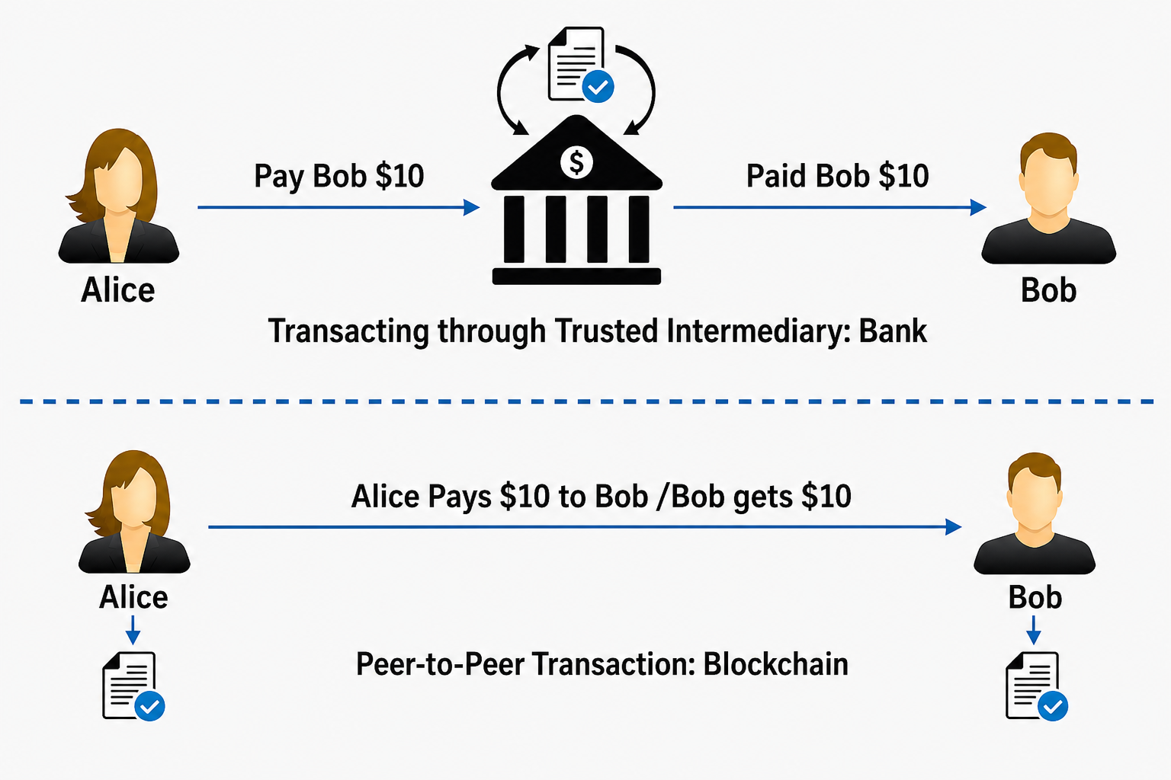
Financial Technology – Blockchain
1.1. Functional Perspective - Peer-to-peer Transaction
Notes:
Engagement and Activity Slides
Note:
Include at least one engagement element where appropriate:
Think–Pair–Share
Mini task
Poll or reflection question
Suggested duration: 3–5 minutes
Activities shall align with learning outcomes

Slide 9
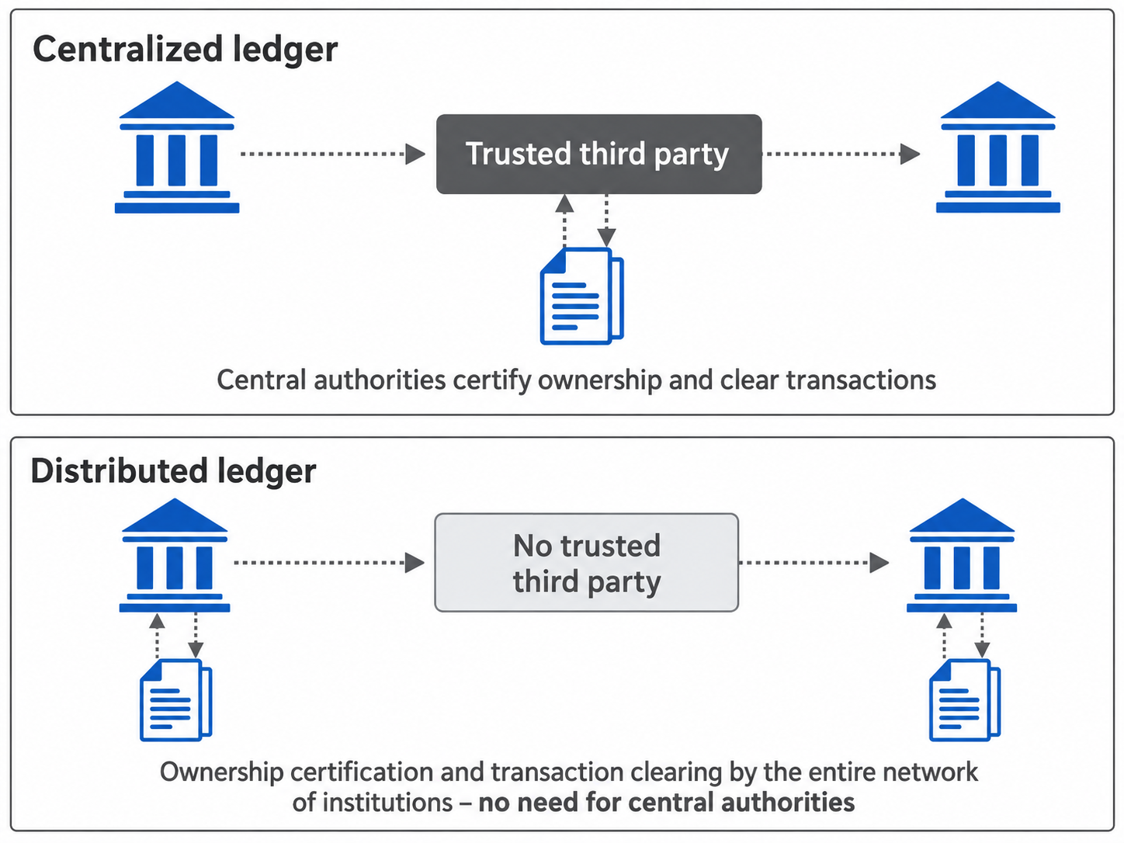
Financial Technology – Blockchain
1.1. Functional Perspective - Peer-to-peer Transaction
Notes:
Engagement and Activity Slides
Note:
Include at least one engagement element where appropriate:
Think–Pair–Share
Mini task
Poll or reflection question
Suggested duration: 3–5 minutes
Activities shall align with learning outcomes

Slide 10
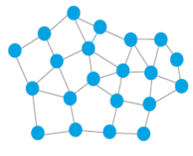
Financial Technology – Blockchain
1.1. Open-Source Distributed Ledgers
Responsibility for maintaining the ledger shared by a group of peers. The current state of the ledger is represented by the peer’s consensus on what records the ledger contains.
Other actors can obtain a copy of the ledger from any of the peers, as there is no single authoritative copy. Other actors can submit new records to any or all of the peers.
Ledger identity and integrity ensured via the consensus process, that specifies how peers reach consensus.
Notes:
Engagement and Activity Slides
Note:
Include at least one engagement element where appropriate:
Think–Pair–Share
Mini task
Poll or reflection question
Suggested duration: 3–5 minutes
Activities shall align with learning outcomes

Slide 11
Open Source Distributed Ledgers
Distributed ledgers on the other hand, do not rely on an authoritative copy. Indeed, one advantage of distributed ledgers is that anyone who wants to review the ledger can easily obtain a copy, as all copies are equal.
The disadvantage is that ensuring the integrity of the ledger is more complicated as we can no longer rely on controlling access to an authoritative, central ledger.
Notes:
Engagement and Activity Slides
Note:
Include at least one engagement element where appropriate:
Think–Pair–Share
Mini task
Poll or reflection question
Suggested duration: 3–5 minutes
Activities shall align with learning outcomes

Slide 12
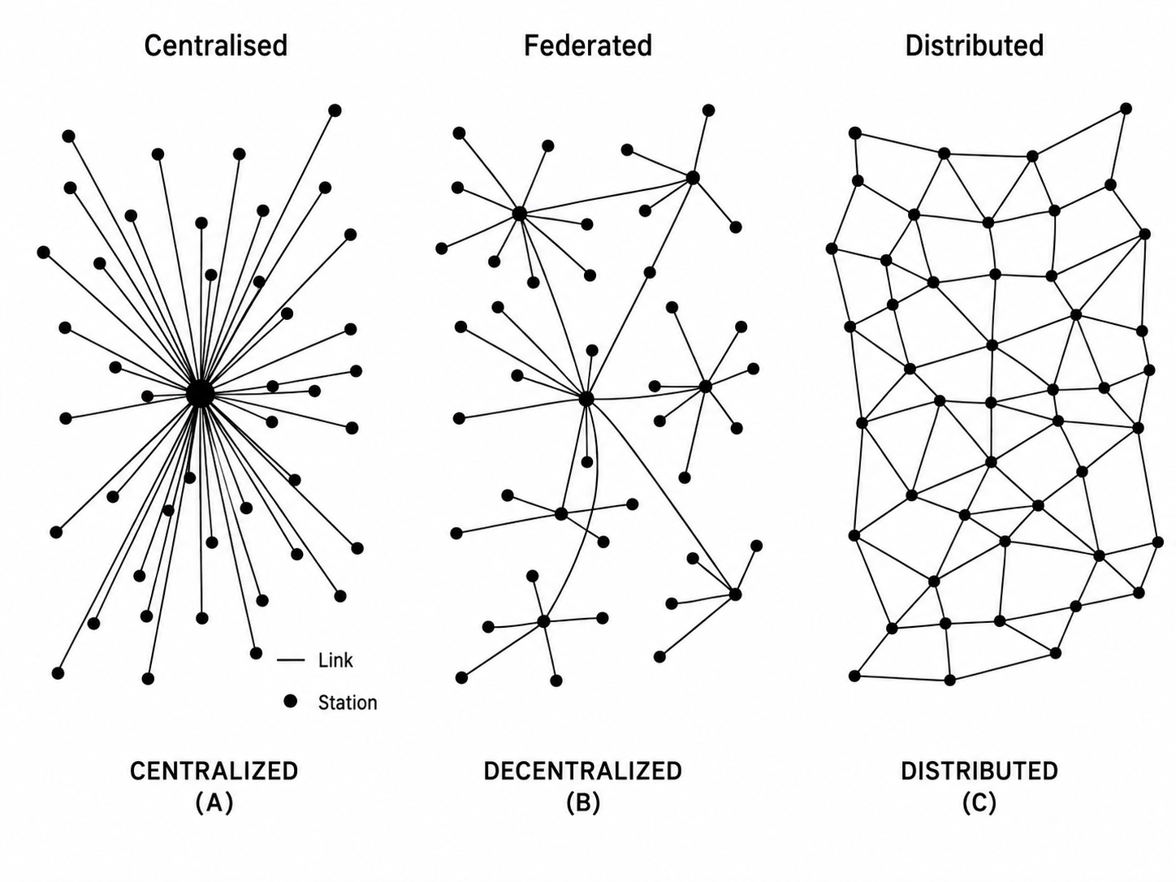
Steps 1 & 2 - Basics
1.1. Types of System
Notes:
Engagement and Activity Slides
Note:
Include at least one engagement element where appropriate:
Think–Pair–Share
Mini task
Poll or reflection question
Suggested duration: 3–5 minutes
Activities shall align with learning outcomes

Slide 13
Steps 1 & 2 - Basics :
Advantages of Distributed Systems
A distributed system consists of a number of independent computers that cooperate with one another by using a communication medium in order to achieve a specific objective without having any centralized element of control or coordination.
The major advantages of a distributed system over single computers are:
Higher computing power
Cost reduction
Higher reliability
Ability to grow naturally
Notes:
Engagement and Activity Slides
Note:
Include at least one engagement element where appropriate:
Think–Pair–Share
Mini task
Poll or reflection question
Suggested duration: 3–5 minutes
Activities shall align with learning outcomes

Slide 14
DISTRIBUTED LEDGER
TECHNOLOGY (BLOCKCHAIN)
Blockchain
Benefits

Slide 15
Financial Technology – Blockchain :
Five Important Blockchain Benefits
Enhanced security
Your data is sensitive and crucial, and blockchain can significantly change how your critical information is viewed. By creating a record that can’t be altered and is encrypted end-to-end, blockchain helps prevent fraud and unauthorized activity.
Privacy issues can also be addressed on blockchain by anonymizing personal data and using permissions to prevent access.
Information is stored across a network of computers rather than a single server, making it difficult for hackers to view data.
Notes:
Engagement and Activity Slides
Note:
Include at least one engagement element where appropriate:
Think–Pair–Share
Mini task
Poll or reflection question
Suggested duration: 3–5 minutes
Activities shall align with learning outcomes

Slide 16
Financial Technology – Blockchain :
Five Important Blockchain Benefits
Greater transparency
Without blockchain, each organization has to keep a separate database. Because blockchain uses a distributed ledger, transactions and data are recorded identically in multiple locations.
All network participants with permissioned access see the same information at the same time, providing full transparency.
All transactions are immutability recorded, and are time-and date-stamped. This enables members to view the entire history of a transaction and virtually eliminates any opportunity for fraud.
Notes:
Engagement and Activity Slides
Note:
Include at least one engagement element where appropriate:
Think–Pair–Share
Mini task
Poll or reflection question
Suggested duration: 3–5 minutes
Activities shall align with learning outcomes

Slide 17
Five Important Blockchain Benefits
Instant traceability
Blockchain creates an audit trail that documents the provenance of an asset at every step on its journey.
In industries where consumers are concerned about environmental or human rights issues surrounding a product — or an industry troubled by counterfeiting and fraud — this helps provide the proof.
With blockchain, it is possible to share data about provenance directly with customers.
Traceability data can also expose weaknesses in any supply chain — where goods might sit on a loading dock awaiting transit.
Notes:
Engagement and Activity Slides
Note:
Include at least one engagement element where appropriate:
Think–Pair–Share
Mini task
Poll or reflection question
Suggested duration: 3–5 minutes
Activities shall align with learning outcomes

Slide 18
Five Important Blockchain Benefits
Increased efficiency and speed
Traditional paper-heavy processes are time-consuming, prone to human error, and often requires third-party mediation.
By streamlining these processes with blockchain, transactions can be completed faster and more efficiently.
Documentation can be stored on the blockchain along with transaction details, eliminating the need to exchange paper. There’s no need to reconcile multiple ledgers, so clearing and settlement can be much faster.
Notes:
Engagement and Activity Slides
Note:
Include at least one engagement element where appropriate:
Think–Pair–Share
Mini task
Poll or reflection question
Suggested duration: 3–5 minutes
Activities shall align with learning outcomes

Slide 19
Five Important Blockchain Benefits
Automation
Transactions can even be automated with “smart contracts,” which increase your efficiency and speed the process even further.
Once pre-specified conditions are met, the next step in transaction or process is automatically triggered.
Smart contracts reduce human intervention as well as reliance on third parties to verify that terms of a contract have been met.
In insurance, for example, once a customer has provided all necessary documentation to file a claim, the claim can automatically be settled and paid.
Notes:
Engagement and Activity Slides
Note:
Include at least one engagement element where appropriate:
Think–Pair–Share
Mini task
Poll or reflection question
Suggested duration: 3–5 minutes
Activities shall align with learning outcomes

Slide 20
DISTRIBUTED LEDGER
TECHNOLOGY (BLOCKCHAIN)
Blockchain
Basics

Slide 21
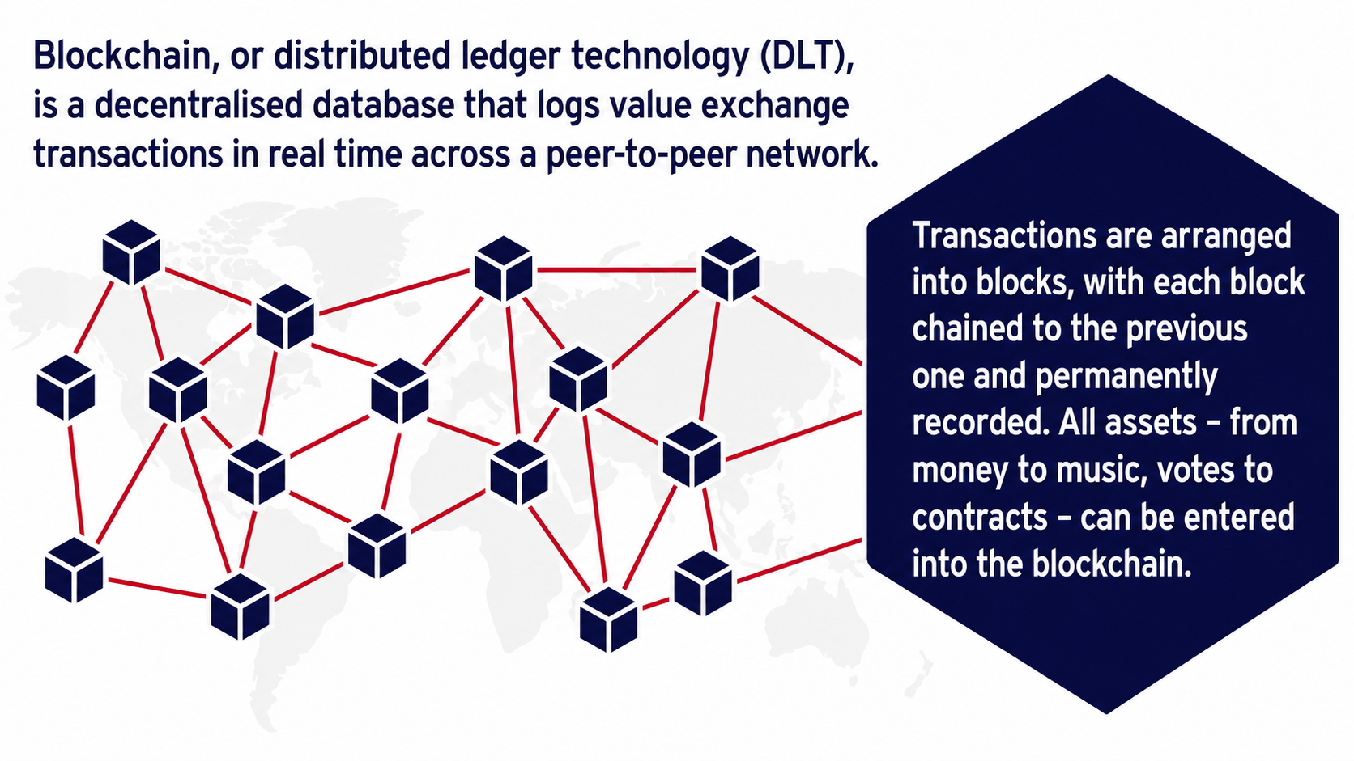
Benefits Financial Technology – Blockchain & Crypto-Currencies
Notes:
Engagement and Activity Slides
Note:
Include at least one engagement element where appropriate:
Think–Pair–Share
Mini task
Poll or reflection question
Suggested duration: 3–5 minutes
Activities shall align with learning outcomes

Slide 22
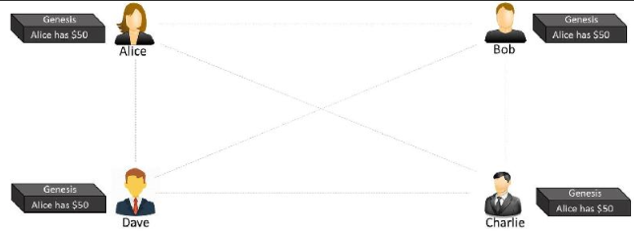
Financial Technology – Blockchain
The Genesis Block
Step-1:
Let us assume that Alice had $50 with her, which is the genesis of all transactions and every node is aware of it,
Notes:
Engagement and Activity Slides
Note:
Include at least one engagement element where appropriate:
Think–Pair–Share
Mini task
Poll or reflection question
Suggested duration: 3–5 minutes
Activities shall align with learning outcomes

Slide 23
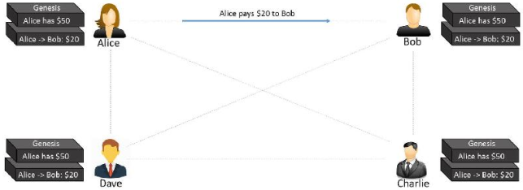
Financial Technology – Blockchain
The First Transaction
Step-2:
Alice makes a transaction by paying $20 to Bob. Observe how the blockchain gets updated at each node
Notes:
Engagement and Activity Slides
Note:
Include at least one engagement element where appropriate:
Think–Pair–Share
Mini task
Poll or reflection question
Suggested duration: 3–5 minutes
Activities shall align with learning outcomes

Slide 24
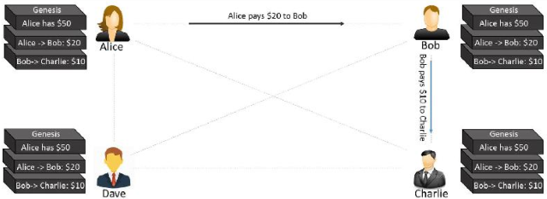
Financial Technology – Blockchain
The Second Transaction
Bob makes another transaction by paying $10 to Charlie and the blockchain gets updated. The transaction data in the blocks is immutable. All transactions are fully irreversible. Any change would result in a new transaction, which would get validated by all contributing nodes. Every node has its own copy of blockchain.
Notes:
Engagement and Activity Slides
Note:
Include at least one engagement element where appropriate:
Think–Pair–Share
Mini task
Poll or reflection question
Suggested duration: 3–5 minutes
Activities shall align with learning outcomes

Slide 25
DISTRIBUTED LEDGER
TECHNOLOGY (BLOCKCHAIN)
Cryptography in
Blockchain

Slide 26
Step 12 - Identifying and Protecting User Accounts
Asymmetric Cryptography
The blockchain uses asymmetric cryptography in order to achieve two goals:
Identifying accounts (public to private)
Authorizing transactions (private to public)
The owner of the account who hands off ownership creates a piece of cypher text with the corresponding private key. This piece of cypher text can be verified by using the corresponding public key, which happens to be the number of the account that hands off ownership.
Notes:
Engagement and Activity Slides
Note:
Include at least one engagement element where appropriate:
Think–Pair–Share
Mini task
Poll or reflection question
Suggested duration: 3–5 minutes
Activities shall align with learning outcomes

Slide 27
Step 13 - Authorizing Transactions (digital signatures)
Digital Signatures in Blockchain
Digital signatures in the blockchain fulfill the following requirements:
They state agreement of the owner of the account who hands off ownership with specific transaction data.
They are unique for the whole content of transaction data in order to prevent it from being used to authorize other transactions without the agreement of its author.
Only the owner of the account who hands off ownership can create such a signature.
They are easy to verify by everyone.
There are two use cases of digital signatures in the blockchain:
Signing a transaction
Verifying a transactions
Notes:
Engagement and Activity Slides
Note:
Include at least one engagement element where appropriate:
Think–Pair–Share
Mini task
Poll or reflection question
Suggested duration: 3–5 minutes
Activities shall align with learning outcomes

Slide 28
Step 13 - Authorizing Transactions (digital signatures)
Signing a Transaction
In order to create a digital signature for a transaction, the owner of the account who hands off ownership performs the following steps:
Describes the transaction with all necessary information such as the involved account numbers, amount being transferred, and so on (except the signature itself as it is not yet available).
Create the cryptographic hash value of the transaction data.
Encrypt the hash value of the transaction with the private key of the account that hands off ownership
Add the cypher text created in point 3 to the transaction as its digital signature
Notes:
Engagement and Activity Slides
Note:
Include at least one engagement element where appropriate:
Think–Pair–Share
Mini task
Poll or reflection question
Suggested duration: 3–5 minutes
Activities shall align with learning outcomes

Slide 29
Step 13 - Authorizing Transactions (digital signatures)
Verifying a Transaction
In order to verify a transaction, the following steps must be performed:
Create the hash value of the transaction data to be verified except the signature itself.
Decrypt the digital signature of the transaction under consideration with the account number that hands off ownership
Compare the hash value of step 1 with the value gained in step 2. If both are identical, the transaction is authorized by the owner of the private key that corresponds to the account that hands off ownership, otherwise it is not.
Notes:
Engagement and Activity Slides
Note:
Include at least one engagement element where appropriate:
Think–Pair–Share
Mini task
Poll or reflection question
Suggested duration: 3–5 minutes
Activities shall align with learning outcomes

Slide 30
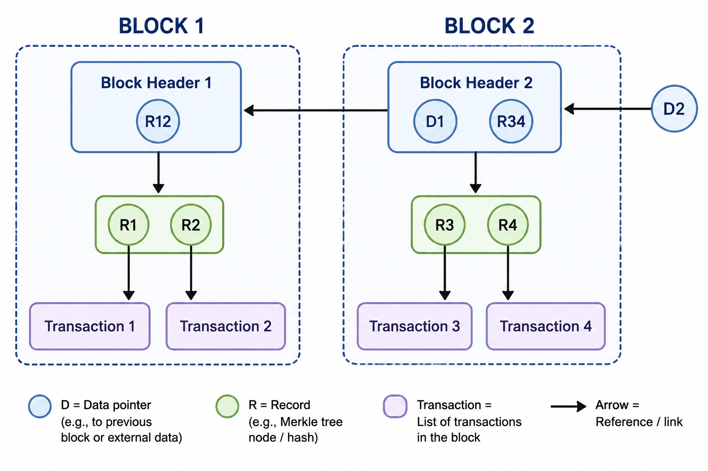
Step 14 - Storing Transaction Data (a history of transaction data)
Blockchain-data-structure
The blockchain-data-structure is a specific kind of data structure that is made up of ordered units called blocks
Notes:
Engagement and Activity Slides
Note:
Include at least one engagement element where appropriate:
Think–Pair–Share
Mini task
Poll or reflection question
Suggested duration: 3–5 minutes
Activities shall align with learning outcomes

Slide 31
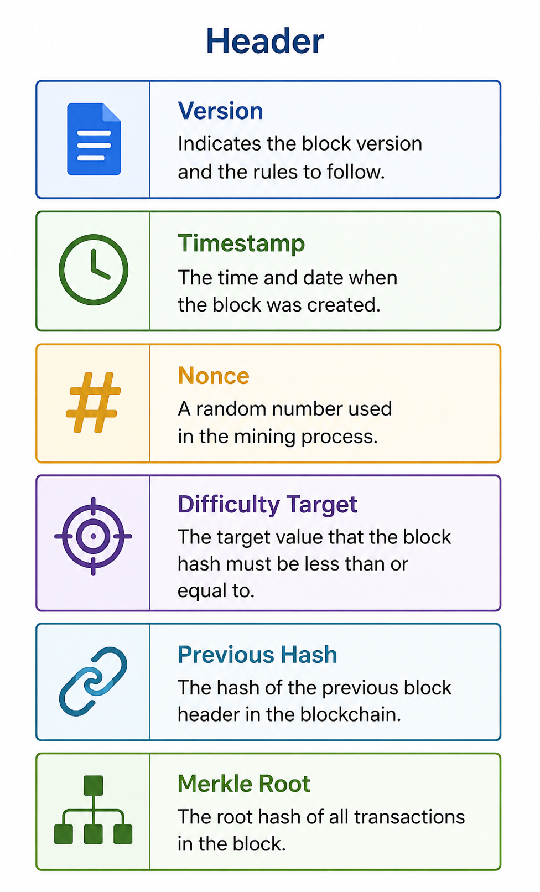
Step 14 - Storing Transaction Data (a history of transaction data)
Blockchain-data-structure
Each block of the blockchain-data-structure consists of an ordered chain of block header and a Merkle tree that contains transaction data
Each block header in the blockchain-data-structure is identified by its cryptographic hash value and contains a hash reference to its preceding block header and a hash reference to the application-specific data whose order it maintains.
The hash reference to the application-specific data is typically the root of a Merkle tree that maintains hash references to the application-specific data.
Notes:
Engagement and Activity Slides
Note:
Include at least one engagement element where appropriate:
Think–Pair–Share
Mini task
Poll or reflection question
Suggested duration: 3–5 minutes
Activities shall align with learning outcomes

Slide 32
Step 13 - Authorizing Transactions (digital signatures)
Block Header
The elements of header are version, timestamp, difficulty target, nonce, previous hash, and Merkle root.
Version is used to read the contents of each block correctly. It helps when updating a block protocol.
Timestamp is the time the block is built. It shows when and what has happened in the block.
Difficulty target is a value set to regulate how quickly a block is solved. For example, the difficulty target is adjusted every 2016 blocks and created an average of 10 minutes between blocks.
Nonce is a dummy number that miners use to get a block hash less than or equal to the target threshold. Once the nonce is discovered, then all transactions in the block are added to the blockchain.
Previous hash is a hash root of the previous block. It is used for connecting with other blocks as a chain.
Merkle root is the hash of all the hashes of all the transactions to form a single line of text. It is used for the chain to next block.
Notes:
Engagement and Activity Slides
Note:
Include at least one engagement element where appropriate:
Think–Pair–Share
Mini task
Poll or reflection question
Suggested duration: 3–5 minutes
Activities shall align with learning outcomes

Slide 33
DISTRIBUTED LEDGER
TECHNOLOGY (BLOCKCHAIN)
Adding & Changing Data in Blockchain

Slide 34
Step 15 - Using the Data Store (chaining blocks of data)
Adding New Transactions in Blockchain
The steps to be performed in order to add new transaction data to the blockchain-data-structure are:
Step 1. Create a new Merkle tree that contains all new transaction data to be added.
Step 2. Create a new block header that contains both a hash reference to its preceding header and the root of the Merkle tree that contains the new transaction data.
Step 3. Create a hash reference to the new block header, which is now the current head of the blockchaindata- structure.
Notes:
Engagement and Activity Slides
Note:
Include at least one engagement element where appropriate:
Think–Pair–Share
Mini task
Poll or reflection question
Suggested duration: 3–5 minutes
Activities shall align with learning outcomes

Slide 35
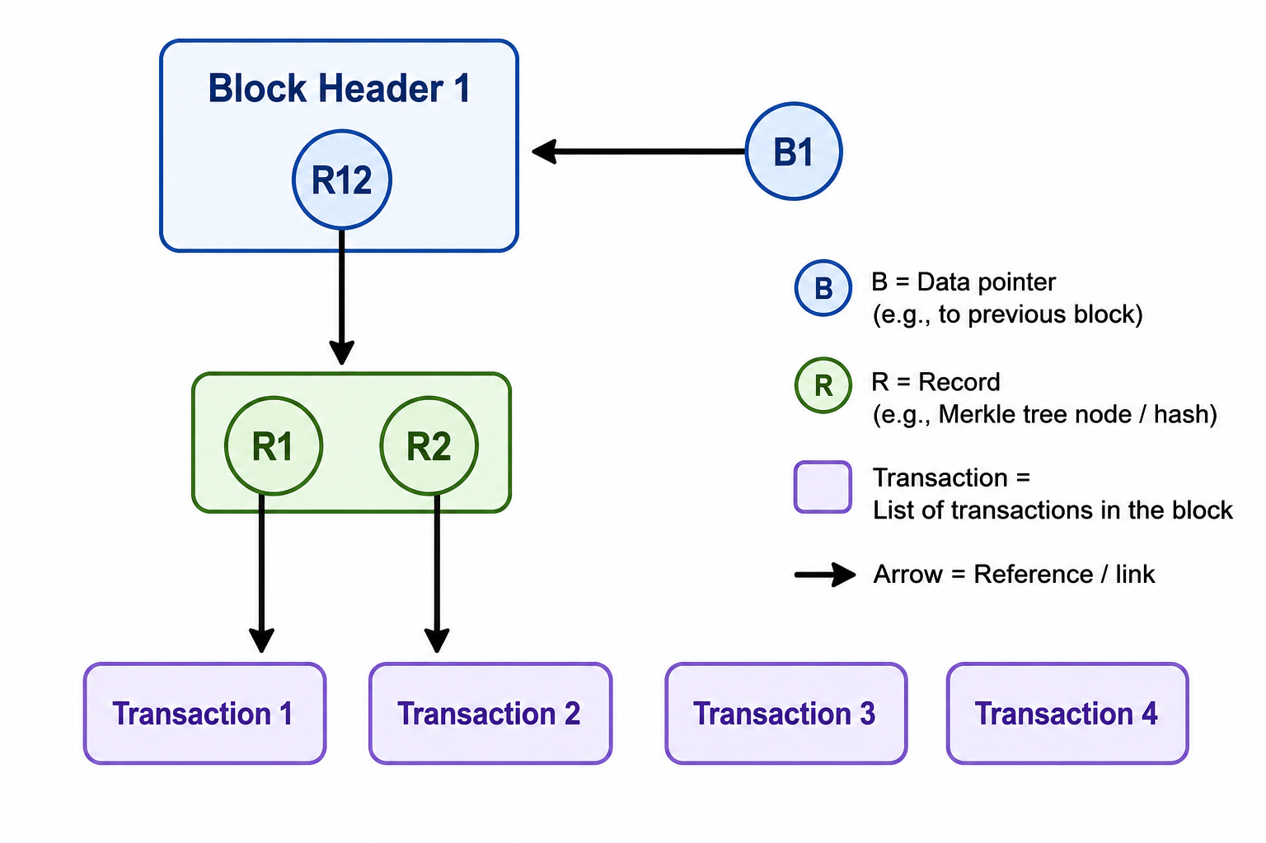
Step 15 - Using the Data Store (chaining blocks of data)
Adding New Transactions in Blockchain
Step 0: Initial situation: Two new transactions (Transaction 3 and Transaction 4) should be added to the existing blockchain-data-structure.
Notes:
Engagement and Activity Slides
Note:
Include at least one engagement element where appropriate:
Think–Pair–Share
Mini task
Poll or reflection question
Suggested duration: 3–5 minutes
Activities shall align with learning outcomes

Slide 36
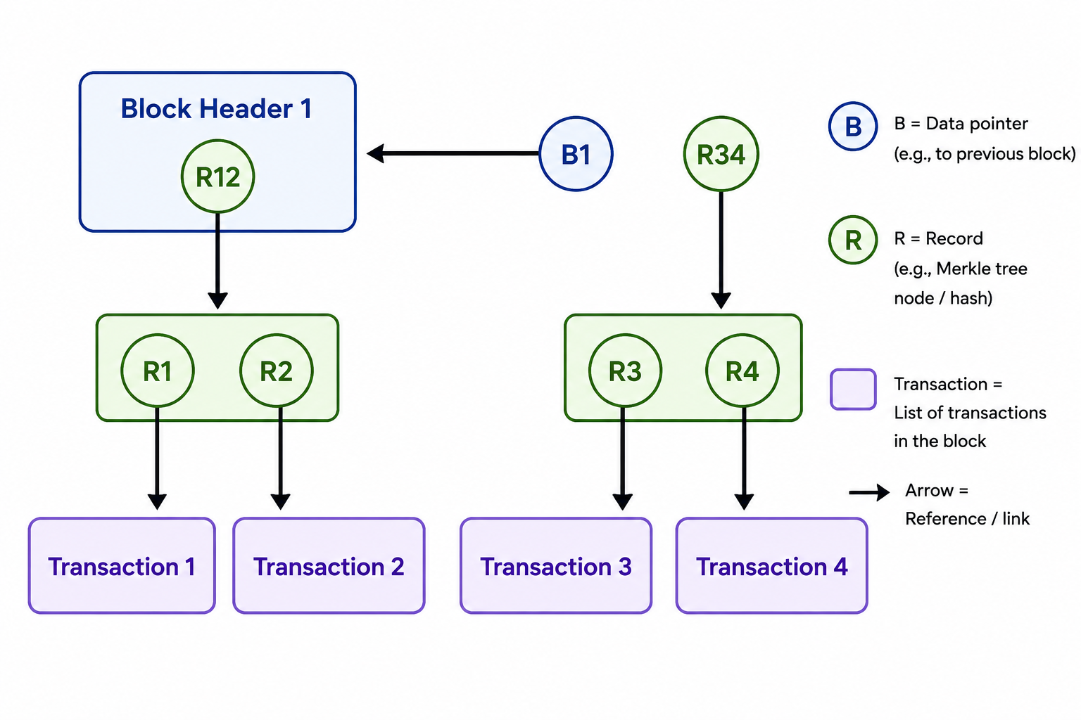
Step 15 - Using the Data Store (chaining blocks of data)
Adding New Transactions in Blockchain
Step 1: Creating a new Merkle tree that contains the new transactions.
Notes:
Engagement and Activity Slides
Note:
Include at least one engagement element where appropriate:
Think–Pair–Share
Mini task
Poll or reflection question
Suggested duration: 3–5 minutes
Activities shall align with learning outcomes

Slide 37
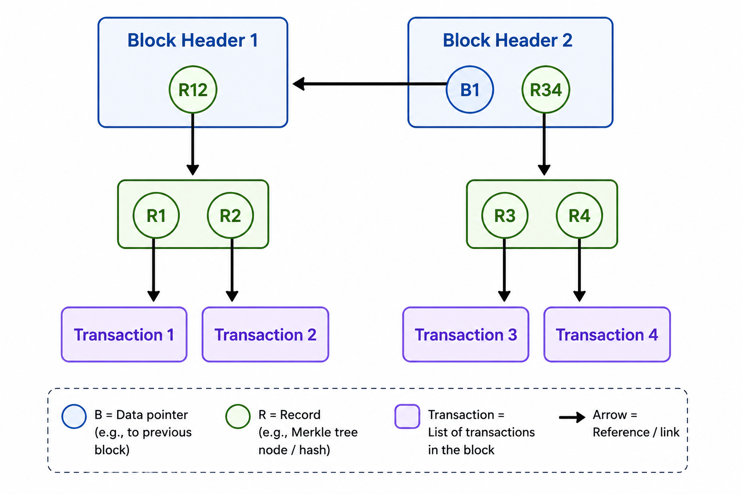
Step 15 - Using the Data Store (chaining blocks of data)
Adding New Transactions in Blockchain
Step 2: Create a new block header that contains both the hash reference to its preceding header and the root of the Merkle tree that contains the new transaction data.
Notes:
Engagement and Activity Slides
Note:
Include at least one engagement element where appropriate:
Think–Pair–Share
Mini task
Poll or reflection question
Suggested duration: 3–5 minutes
Activities shall align with learning outcomes

Slide 38
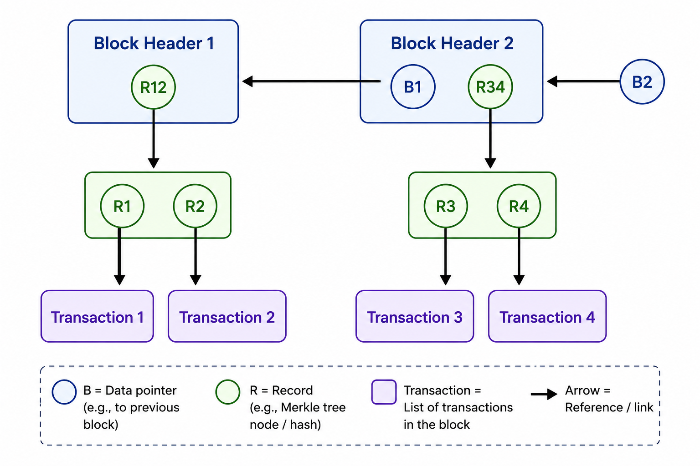
Step 15 - Using the Data Store (chaining blocks of data)
Adding New Transactions in Blockchain
Step 3 : Create a new hash reference that points to the new block header, which is now the new head of the whole updated blockchain-data-structure.
Notes:
Engagement and Activity Slides
Note:
Include at least one engagement element where appropriate:
Think–Pair–Share
Mini task
Poll or reflection question
Suggested duration: 3–5 minutes
Activities shall align with learning outcomes

Slide 39
Step 15 - Using the Data Store (chaining blocks of data)
Node and Miner
A node is a communication point in the blockchain network. Any computer or server can be a node.
All nodes are connected to each other in a P2P network. A node’s responsibilities are maintaining the ledger, receiving transactions from other nodes, and validating transactions
A node can be set to either online or offline. Online nodes are receiving, saving, and broadcasting all the latest blocks of transactions from and to other nodes, while offline nodes do not.
A master node requires much more resources, including electricity, storage space, and memory because it is hosting a very large server on the network.
Notes:
Engagement and Activity Slides
Note:
Include at least one engagement element where appropriate:
Think–Pair–Share
Mini task
Poll or reflection question
Suggested duration: 3–5 minutes
Activities shall align with learning outcomes

Slide 40
Node and Miner
A miner is a specific node to participate in performing the block verification process. It determines whether each transaction is legitimate.
For example, if the block including the encrypted transaction is broadcasted, miners perform the tasks necessary to confirm and validate the block itself. Once the validation process has been completed, the original miner who performed the initial validation broadcasts this block and associated validation information to the rest of the network.
Then, other miners participate in verifying this PoW to establish the legitimacy of the transaction in that particular block.
Notes:
Engagement and Activity Slides
Note:
Include at least one engagement element where appropriate:
Think–Pair–Share
Mini task
Poll or reflection question
Suggested duration: 3–5 minutes
Activities shall align with learning outcomes

Slide 41
Step 15 - Using the Data Store (chaining blocks of data)
Changing Data in Blockchain
The blockchain-data-structure pursues a radical all-or-nothing approach when it comes to changing its data: One either changes the whole data structure completely starting from the point that causes the change until the head of the whole chain or one better leave it unchanged in the first place
All half-hearted, halfway through, or partial changes will leave the whole blockchain-data-structure in an inconsistent state, which will be detected easily and quickly.
The high sensitivity of the blockchain-data-structure regarding changes is due to the properties of hash references
Notes:
Engagement and Activity Slides
Note:
Include at least one engagement element where appropriate:
Think–Pair–Share
Mini task
Poll or reflection question
Suggested duration: 3–5 minutes
Activities shall align with learning outcomes

Slide 42
Changing Data in Blockchain
Conclusion : Any alteration of data stored in the blockchain-data-structure will stand out and require an elaborate process for incorporating it into the existing structure.
Only 1 megabyte of transaction data can fit into a single bitcoin block. The 1MB limit was set by Satoshi Nakamoto.
Notes:
Engagement and Activity Slides
Note:
Include at least one engagement element where appropriate:
Think–Pair–Share
Mini task
Poll or reflection question
Suggested duration: 3–5 minutes
Activities shall align with learning outcomes

Slide 43
DISTRIBUTED LEDGER
TECHNOLOGY (BLOCKCHAIN)
Blockchain vs. Typical
Database

Slide 44
Step 15 - Using the Data Store (chaining blocks of data)
Blockchain vs Existing Centralized Database
One key difference between a typical database and a blockchain is how the data is structured. A blockchain collects information together in groups, known as blocks, that hold sets of information.
Blocks have certain storage capacities and, when filled, are closed and linked to the previously filled block, forming a chain of data known as the blockchain. All new information that follows that freshly added block is compiled into a newly formed block that will then also be added to the chain once filled.
A database usually structures its data into tables, whereas a blockchain structures its data into chunks (blocks) that are strung together. This data structure inherently makes an irreversible timeline of data when implemented in a decentralized nature. When a block is filled, it is set in stone and becomes a part of this timeline. Each block in the chain is given an exact time stamp when it is added to the chain.
Notes:
Engagement and Activity Slides
Note:
Include at least one engagement element where appropriate:
Think–Pair–Share
Mini task
Poll or reflection question
Suggested duration: 3–5 minutes
Activities shall align with learning outcomes

Slide 45
Blockchain vs Existing Centralized Database
As new data comes in, it is entered into a fresh block. Once the block is filled with data, it is chained onto the previous block, which makes the data chained together in chronological order.
Different types of information can be stored on a blockchain, but the most common use so far has been as a ledger for transactions
In Bitcoin’s case, blockchain is used in a decentralized way so that no single person or group has control—rather, all users collectively retain control.
Decentralized blockchains are immutable, which means that the data entered is irreversible. For Bitcoin, this means that transactions are permanently recorded and viewable to anyone.
Notes:
Engagement and Activity Slides
Note:
Include at least one engagement element where appropriate:
Think–Pair–Share
Mini task
Poll or reflection question
Suggested duration: 3–5 minutes
Activities shall align with learning outcomes

Slide 46
Step 15 - Using the Data Store (chaining blocks of data)
How Industries Benefit From Blockchain
Blockchain benefits in supply chains and food chain
Building trust between trading partners, providing end-to-end visibility, streamlining processes, and resolving issues faster with blockchain all add up to stronger, more resilient supply chains and better business relationships. Plus, participants can act sooner in the event of disruptions. In the food industry, blockchain can help ensure food safety and freshness, and reduce waste. In the event of contamination, food can be traced back to its source in seconds rather than days.
Notes:
Engagement and Activity Slides
Note:
Include at least one engagement element where appropriate:
Think–Pair–Share
Mini task
Poll or reflection question
Suggested duration: 3–5 minutes
Activities shall align with learning outcomes

Slide 47
How Industries Benefit From Blockchain
Banking and financial industry blockchain benefits
When financial institutions replace old processes and paperwork with blockchain, the benefits include ...
removing friction and delays,
increasing operational efficiencies across the industry, including global trade, trade finance, clearing and settlement, consumer banking, lending, and other transactions.
Healthcare blockchain benefits
In an industry troubled by data breaches, blockchain can help healthcare improve security for patient data while making it easier to share records across providers, payers and researchers. Control over access remains in the hands of the patient, increasing trust
Notes:
Engagement and Activity Slides
Note:
Include at least one engagement element where appropriate:
Think–Pair–Share
Mini task
Poll or reflection question
Suggested duration: 3–5 minutes
Activities shall align with learning outcomes

Slide 48
How Industries Benefit From Blockchain
Pharmaceutical blockchain benefits
As pharmaceutical products move through the supply chain, every action is recorded. The resulting audit trail means an item can be traced from origin to pharmacy or retailer, helping to prevent counterfeiting and enabling manufacturers to locate a recalled product in seconds.
Government blockchain benefits
Blockchain can help governments work smarter and innovate faster. Secure sharing of data between citizens and agencies can increase trust while providing an immutable audit trail for regulatory compliance, contract management, identity management, and citizen services.
Notes:
Engagement and Activity Slides
Note:
Include at least one engagement element where appropriate:
Think–Pair–Share
Mini task
Poll or reflection question
Suggested duration: 3–5 minutes
Activities shall align with learning outcomes

Slide 49
How Industries Benefit From Blockchain
Insurance blockchain benefits
Insurance companies are using blockchain and smart contracts to automate manual and paper-intensive processes such as underwriting and claims settlement, increasing speed and efficiency, and reducing costs. Blockchain’s faster, verifiable data exchanges help reduce fraud and abuse.
Notes:
Engagement and Activity Slides
Note:
Include at least one engagement element where appropriate:
Think–Pair–Share
Mini task
Poll or reflection question
Suggested duration: 3–5 minutes
Activities shall align with learning outcomes

Slide 50
Blockchain – PWC (Oct 2020) Report :
Blockchain Good Videos
Blockchain – Basics
https://www.youtube.com/watch?v=qOVAbKKSH10
Blockchain Use Cases – Blockchain City
https://www.youtube.com/watch?v=I6fadL-0VRw
Blockchain Use Cases – Blockchain and Us
https://www.youtube.com/watch?v=2iF73cybTBs
Notes:
Engagement and Activity Slides
Note:
Include at least one engagement element where appropriate:
Think–Pair–Share
Mini task
Poll or reflection question
Suggested duration: 3–5 minutes
Activities shall align with learning outcomes

Slide 51
SUMMARY
By the end of this session:
This document introduces blockchain as a decentralized, peer-to-peer distributed ledger technology that securely records transactions without relying on trusted third-party intermediaries.
It details five primary benefits of the technology: enhanced security, greater transparency, instant traceability, increased efficiency, and automation via smart contracts.
The text explains the underlying mechanics, noting that blockchain ensures data immutability using asymmetric cryptography, digital signatures, and a data structure of interconnected blocks linked by cryptographic hashes。
Finally, it highlights practical applications, demonstrating how blockchain transforms operations and builds trust across diverse industries like supply chain, banking, healthcare, and government
Notes:
Summary and Closure Slides
Note:
Summarise 3–5 key takeaways
Reinforce main ideas
Indicate CLO coverage where appropriate
Include:
Upcoming topics
Required reading
Tutorial / lab / assessment linkage

Slide 52

THANK YOU
Shuhaida Bt M Shuhidan
DEPARTMENT OF COMPUTING
shuhaida.shuhidan@utp.edu.my
01-03-31

